Slide 1
Spring Batch Overview

Slide 2
Agenda
Spring Batch Overview
Domain Language of Batch
Configuring and Running a Job
Miscellaneous
Summary

Slide 3
Spring Batch Introduction
Spring Batch is the first java based framework for batch processing
¤ a lightweight, comprehensive batch framework
¤ builds upon the productivity, POJO-based development approach, known from the Spring Framework

Slide 4
Batch Processing
What is a Batch Application?
¤ Batch applications need to process high volume business critical transactional data
¤ A typical batch program generally
reads a large number of records from a database, file, or queue
processes the data in some fashion, and
then writes back data in a modified form

Slide 5
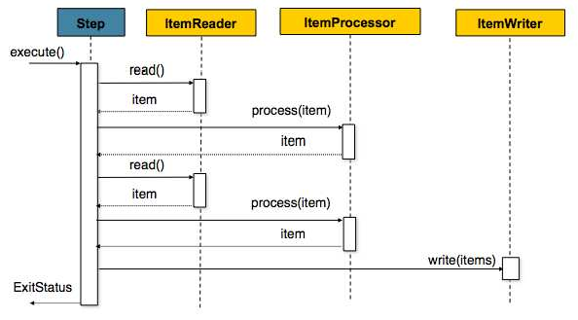
Item Oriented Processing

Slide 6
Usage Scenarios
Commit batch process periodically
Concurrent batch processing: parallel processing of a job
Staged, enterprise message-driven processing
Massively parallel batch processing
Manual or scheduled restart after failure
Sequential processing of dependent steps (with extensions to workflow-driven batches)
Partial processing: skip records (e.g. on rollback)
Whole-batch transaction: for cases with a small batch size or existing stored procedures/scripts

Slide 7



















Spring Batch: Layered Architecture

Slide 8
Agenda
Spring Batch Overview
Domain Language of Batch
Configuring and Running a Job
Miscellaneous
Summary

Slide 9










Domain Language of Batch
A job has one to many steps
A step has exactly one ItemReader, ItemWriter and optionally an
ItemProcessor
A job needs to be launched (JobLauncher)
Meta data about the running process needs to be stored (JobRepository)

Slide 10














Domain Language of Batch
Job
¤ encapsulates an entire batch process
Job Instance
¤ refers to the concept of a logical job run
¤ job running once at end of day, will have one logical JobInstance per day
¤ each JobInstance can have multiple executions
Job Execution
¤ refers to the technical concept of a single attempt to run a Job
¤ An execution may end in failure or success, but the JobInstance
will not be considered complete unless the execution completes successfully
Job Parameters
¤ is a set of parameters used to start a batch job
¤ JobInstance = Job + JobParameters

Slide 11





Domain Language of Batch
Step
¤ a domain object that encapsulates an independent, sequential phase of a batch job
¤ can be as simple or complex as the developer desires
Step Execution
¤ represents a single attempt to execute a Step
¤ A new StepExecution will be created each time a Step is run, similar to JobExecution
¤ A StepExecution will only be created when its Step is actually started

Slide 12
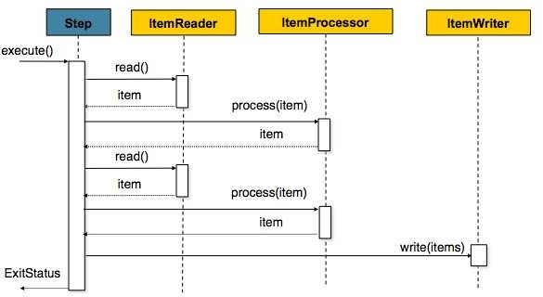
Domain Language of Batch
Item Reader
¤ an abstraction that represents the retrieval of input for a Step
one item at a time
¤ When it has exhausted the items it can provide, it will indicate this by returning null
¤ Various implementation available out-of-the-box
Item Writer
¤ an abstraction that represents the output of a Step
Chunk-oriented processing
¤ Generally, an item writer has no knowledge of the input it will receive next
¤ Various implementation available out-of-the-box
Item Processor
¤ an abstraction that represents the business processing of an item
¤ provides access to transform or apply other business processing
¤ returning null indicates that the item should not be written out

Slide 13
Domain Language of Batch
ItemReader
public interface ItemReader<T> {
T read() throws Exception, UnexpectedInputException,
ParseException;
}
ItemWriter
public interface ItemWriter<T> {
void write(List<? extends T> items) throws Exception;
}
ItemProcessor
public interface ItemProcessor<I, O> { O process(I item) throws Exception;
}

Slide 14
Domain Language of Batch
Job Repository
¤ the persistence mechanism for all of the Stereotypes
¤ provides CRUD operations for JobLauncher, Job, and Step
implementations
Job Launcher
¤ represents a simple interface for launching a Job with a given set of
JobParameters
public interface JobLauncher { public JobExecution run(Job job,
JobParameters jobParameters) throws JobExecutionAlreadyRunningException,
JobRestartException;
}

Slide 15
Agenda
Spring Batch Overview
Domain Language of Batch
Configuring and Running a Job
Miscellaneous
Summary

Slide 16
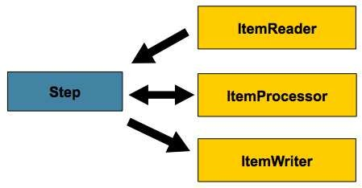
Configuring and Running a Job
Configuring a Job and its steps
¤ There are multiple implementations of the Job interface, however, the namespace abstracts away the differences in configuration
¤ It has only three required dependencies: a name, JobRepository,
and a list of Steps
<job id="sampleJob">
<step id="step1" job-repository="jobRepository" transaction-manager="transactionManager">
<tasklet reader="itemReader" writer="itemWriter" commit-interval="10"/>
</step>
</job>
<bean id="itemReader" ...>
<bean id="itemWriter" ...>

Slide 17
Configuring and Running a Job
Configuring a Job Repository
¤ used for basic CRUD operations of the various persisted domain objects such as JobExecution and StepExecution
¤ batch namespace abstracts away many of the implementation details
<job-repository id="jobRepository"
dataSource="dataSource" transactionManager="transactionManager" isolation-level-for-create="serializable" table-prefix="BATCH_" />
Configuring a Job Launcher
<bean id="jobLauncher" class="...batch.execution.launch.SimpleJobLauncher">
<property name="jobRepository" ref="jobRepository" />
</bean>

Slide 18
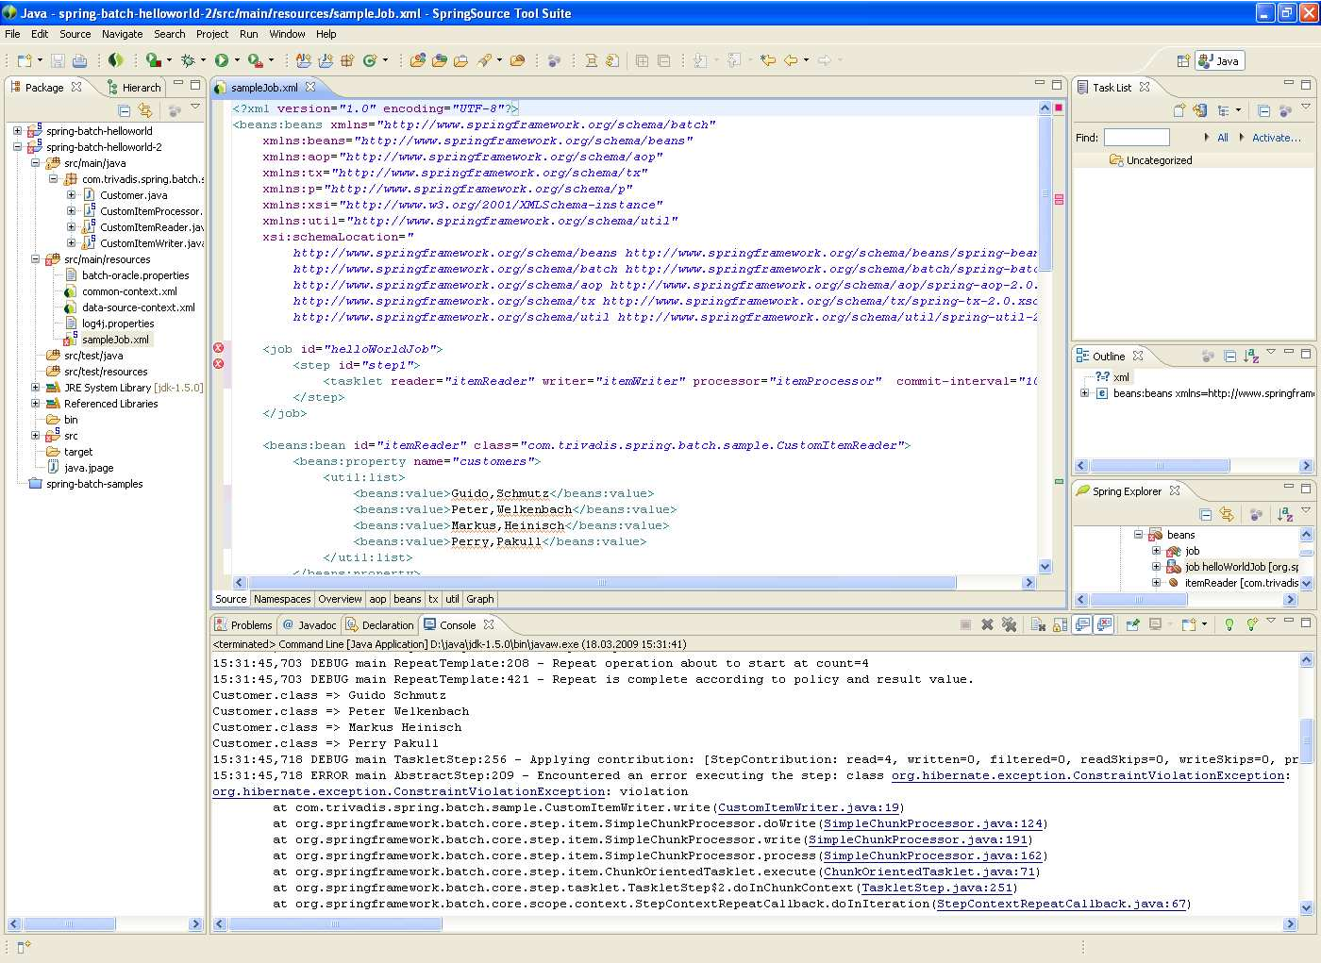
Demo

Slide 19
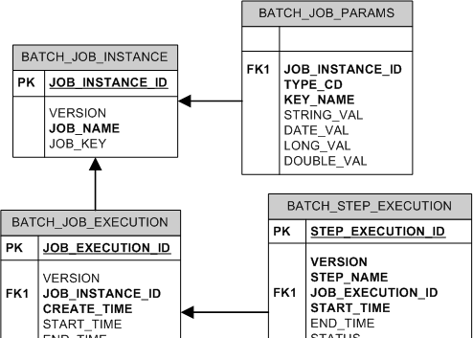
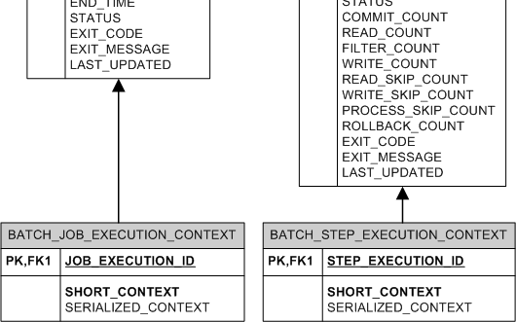
Meta-Data Schema
The Spring Batch Meta-Data tables very closely match the Domain objects that represent them in Java

Slide 20
Agenda
Spring Batch Overview
Domain Language of Batch
Configuring and Running a Job
Miscellaneous
Summary

Slide 21









































Spring Batch in Trivadis Integration Architecture Blueprint

Slide 22
Sequential Flow
Step A
The simplest flow scenario is a job where all of the steps execute sequentially
This can be achieved using the 'next' attribute of the step element
Step B
<job id="job">
<step id="stepA" next="stepB" />
<step id="stepB" next="stepC"/>
<step id="stepC"/>
</job>
Step C

Slide 23







Conditional Flow
In order to handle more complex scenarios, Spring Batch allows transition elements to be defined within the step element
<job id="job">
<step id="stepA">
<next on="FAILED" to="stepB" />
<next on="*" to="stepC" />
</step>
<step id="stepB" next="stepC" />
<step id="stepC" />
</job>

Slide 24
Split Flow
Step A
Spring Batch also allows for a job to
Step B11
be configured with parallel flows using the 'split' element
Step B21
Step B12
<step id="stepA" next="stepB"/>
<split id="stepB" next="stepC">
<flow>
<step id="stepB11" next="stepB11"/>
<step id="stepB12"/>
</flow>
<flow>
<step id="stepB21"/>
</flow>
</split>
<step id="stepC"/>
Step C

Slide 25
Restartablility
The launching of a Job is considered to be a 'restart' if a
JobExecution already exists for the particular JobInstance.
¤ Ideally, all jobs should be able to start up where they left off
¤ but there are scenarios where this is not possible
If a Job should never be restarted, but should always be run as part of a new JobInstance, then the restartable property may be set to 'false‘
<job id="footballJob" restartable="false">
<step id="playerload" next="gameLoad"/>
<step id="gameLoad" next="playerSummarization"/>
<step id="playerSummarization"/>
</job>

Slide 26
Configuring a Step for Restart
Setting a StartLimit
¤ control the number of times a Step may be started
<step id="step1">
<tasklet reader="itemReader" writer="itemWriter" commit-interval="10" start-limit="1"/>
</step>
Restarting a completed step
¤ In a restartable job, one or more steps should always be run, regardless of whether or not they were successful the first time
<step id="step1">
<tasklet reader="itemReader" writer="itemWriter" commit-interval="10"
allow-start-if-complete="true"/>
</step>

Slide 27
Configuring Skip Logic
there are scenarios where errors encountered should not result in Step failure, but should be skipped instead
<step id="step1">
<tasklet reader="flatFileItemReader" writer="itemWriter" commit-interval="10" skip-limit="10">
<skippable-exception-classes> org.springframework.batch.item.file.FlatFileParseExcept ion
</skippable-exception-classes>
</tasklet>
</step>

Slide 28
Configuring Fatal Exceptions
it may be easier to identify which exceptions should cause failure and skip everything else
<step id="step1">
<tasklet reader="flatFileItemReader" writer="itemWriter" commit-interval="10" skip-limit="10">
<skippable-exception-classes> java.lang.Exception
</skippable-exception-classes>
<fatal-exception-classes> java.io.FileNotFoundException
</fatal-exception-classes>
</tasklet>
</step>

Slide 29
Intercepting Step Execution
You might need to perform some functionality at certain events during the execution of a Step
<step id="step1">
<tasklet reader="reader" writer="writer" commit-interval="10"/>
<listeners>
<listener ref="stepListener"/>
</listeners>
</step>
¤ can be accomplished with one of many Step scoped listeners, like
StepExecutionListener
ChunkListener
ItemReadListener
ItemProcessListener
ItemWriteListener
SkipListener

Slide 30
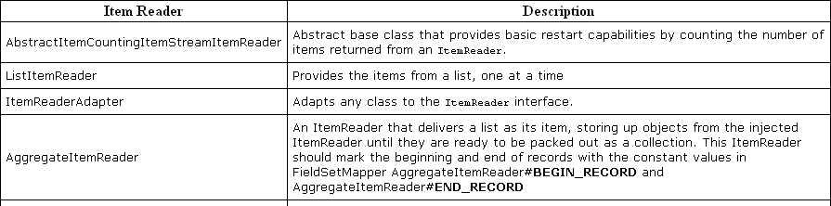
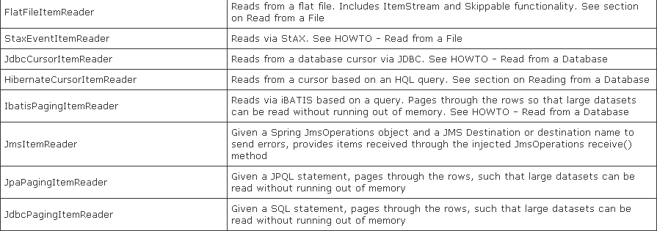
Available Item Readers

Slide 31
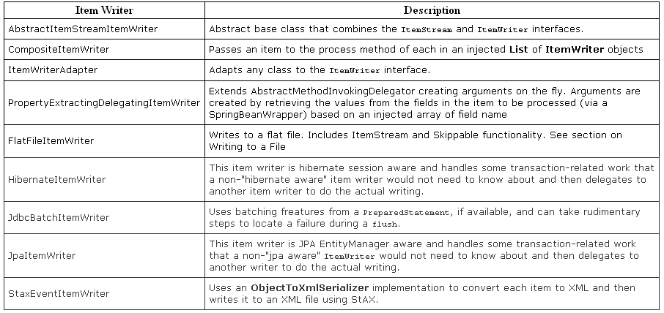
Available Item Writers

Slide 32
Agenda
Spring Batch Overview
Domain Language of Batch
Configuring and Running a Job
Miscellaneous
Summary

Slide 33
Summary
Lack of a standard enterprise batch architecture is resulting in higher costs associated with the quality and delivery of solutions.
Spring Batch provides a highly scalable, easy-to-use, customizable, industry-accepted batch framework collaboratively developed by Accenture and SpringSource
Spring patterns and practices have been leveraged allowing developers to focus on business logic, while enterprise architects can customize and extend architecture concerns

Slide 34
Spring Batch Launch Environment
Run Tier
¤ concerned with the scheduling and launching of the application
¤ a vendor product is typically used in this tier to allow
time-based and interdependent scheduling of batch jobs
providing parallel processing capabilities
Job Tier
¤ responsible for the overall execution of a batch job
¤ sequentially executes batch steps, ensuring that all steps are in the correct state and all appropriate policies are enforced
Application Tier
¤ contains components required to execute the program
¤ contains specific modules that address the required batch functionality and enforces policies around a module execution (e.g., commit intervals, capture of statistics, etc.)
Data Tier
¤ provides the integration with the physical data sources that might include databases, files, or queues.

Slide 35














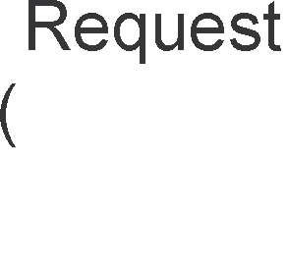
























Spring Batch Launch Environment

